Slide 1
Hackathon: 2018
By: Shatrunjai Singh
Lead Data Scientist,
New Care Model Analytics,
Clinical Analytics
Sep 2018
Consumer Healthcare & Services
Strictly confidential

Slide 2
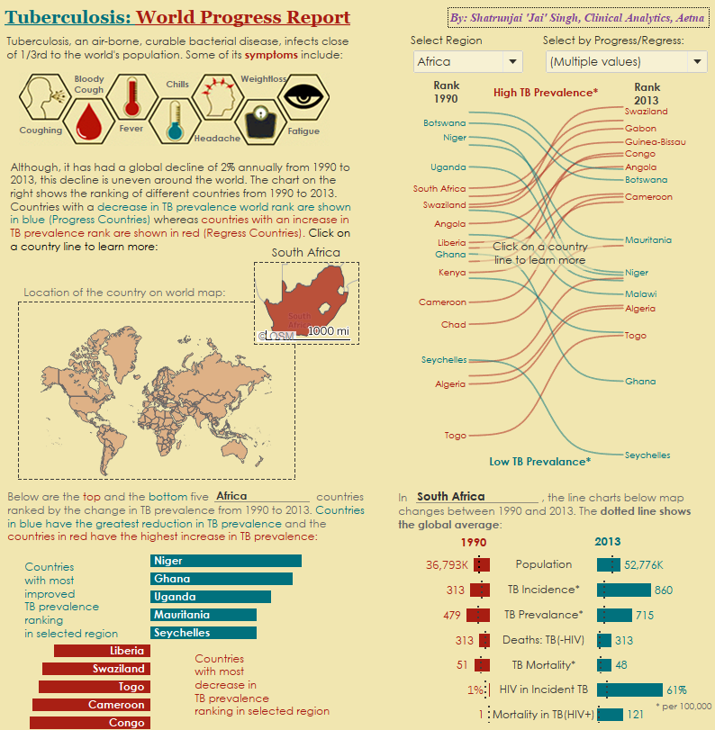
The Change TB Prevalence around the World (1990-2013)
The Tableau dashboard looks at the change in
Prevalence of TB around the world from 1990 to
2013
The design is in the form of an infographic
and uses a yellow/red/blue color scheme inline
with the ‘disease’ theme
The infographic starts with descriptions
about TB and its most common symptoms
All the countries were ranked according to
‘Prevalence of TB per 100,000 people’, with high
Prevalence countries getting the lowest ranks and
vice-versa. This was done for both 1990 and
2013
A change in rank was plotted via Sankey
(energy flow) charts and countries with a
decrease in prevalence were marked as ‘progress’
and the ones with increased prevalence were
marked as ‘regress’. Countries with little change
were marked as ‘Others’’.

Slide 3
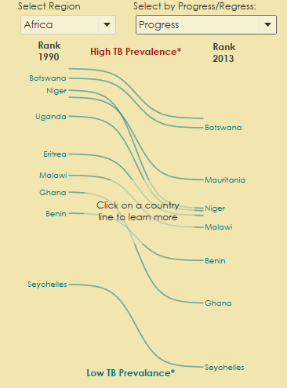
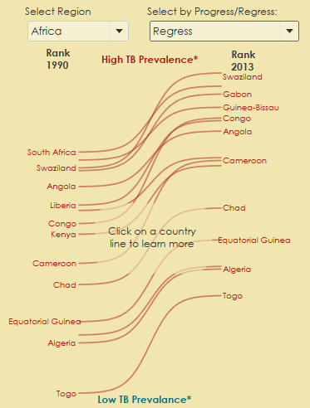
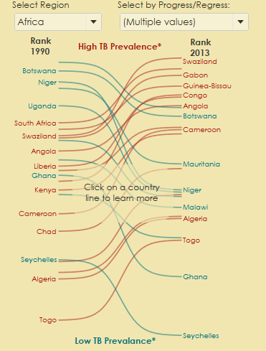
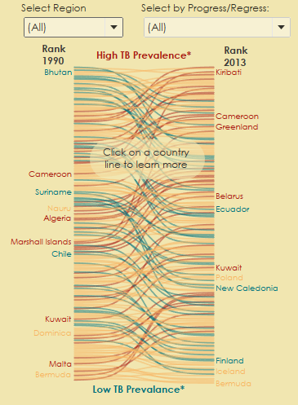
Sankey Charts: Change in TB prevalence ranking from 1990 to 2013
Select world region?
Select Progress/Regress?
Top has high prevalence ranking countries
Filtered to show only countries that have had a decrease in TB Prevalence from 1990 to 2013
Filtered to show only countries that have had a increase in TB Prevalence from 1990 to 2013
Bottom has low prevalence ranking countries
Show all countries, both increase/decrease and no change in prevalence

Slide 4
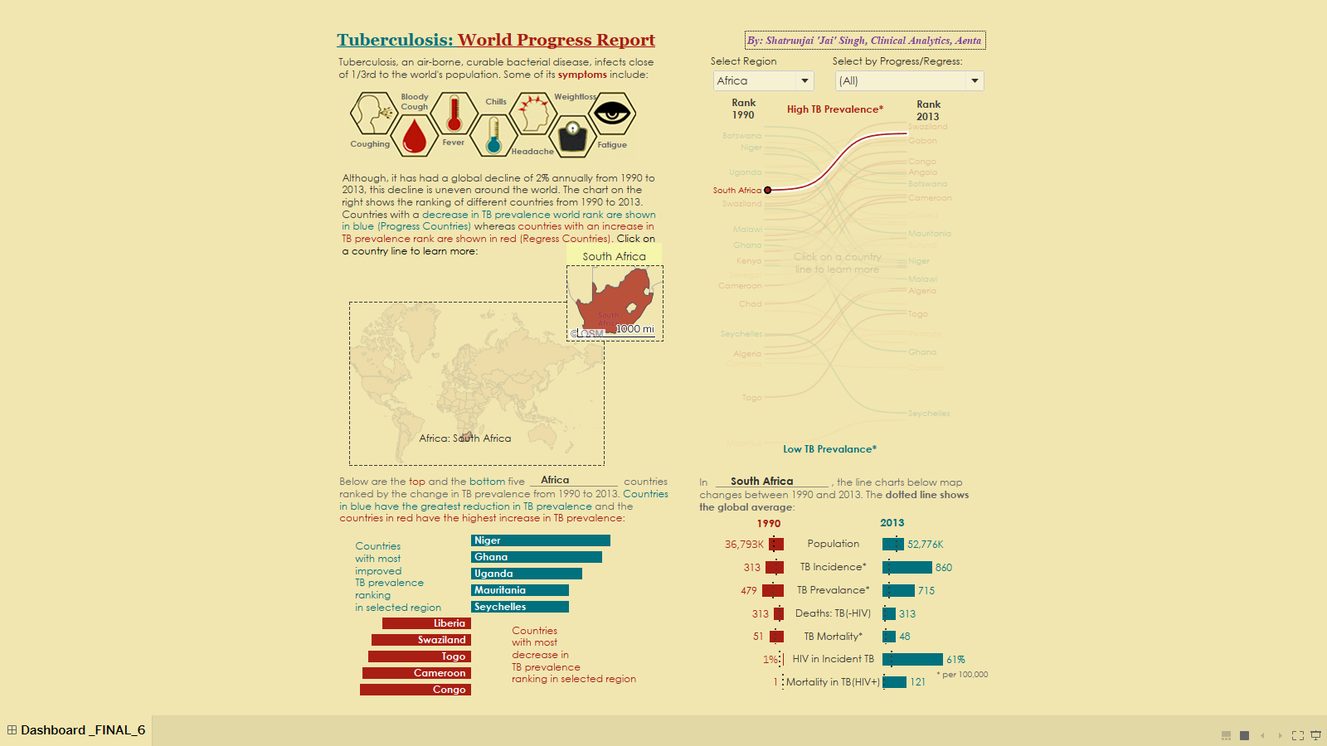
Maps and butterfly charts give country specific drilldowns
The location of the country on the world map is highlighted and the zoomed in map of the country is displayed
South Africa had more TB prevalence than the global Average for population in 2013
Clicking on a country line shows more details on the other panels in the dashboard.
South Africa increased in TB Prevalence world ranking from 1990 to 2013!
Global Average
(dotted line)
The change in other metrics (population, TB Incidence/Prevalence, etc.) from 1990 to 2013 is also shown
South Africa had slightly higher TB prevalence than the global Average for population in 1990

Slide 5
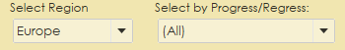

Butterfly chart to see the Top and Bottom 5 countries by Region
Another butterfly chart shows the TOP and the BOTTOM 5 countries according to the change in TB Prevalence from 1990 to 2013
Here, on selecting ‘Europe’ in the region: we see countries like Azerbaijan and Andorra have had the highest decrease in TB prevalence in Europe (and thus the biggest decrease in ranking)
Conversely, countries like Malta and Ukraine have had the highest increase in TB prevalence and thus increase in ranking

Slide 6
Tableau Dashbaord Link
Link to published dashboard on Clinical Analytics Server:
https://devtableau.aetna.com/t/DataScience/views/T_01_Hackathon_2018_09_03_v7/Hackathon_Dashboard?iframeSizedToWindow=true&:embed=y&:showAppBanner=false&:display_count=no&:showVizHome=no
Note: The workbooks appears a little different on different screens

